Slide 1
45 Day Check-in
GO Team Meeting #3

Slide 2
Agenda
CIP-45 Day Check-in
School Strategic Plan
Discussion on Strategic Plan and progress
Updates for Strategic Plan (as necessary)

Slide 3
Timeline for GO Teams
You are HERE
1
2
3
4
5
1
2
3
4
5
Fall 2021
GO Team Developed 2021-2025 Strategic Plan
Summer 2022
School Leadership completed Needs Assessment and defined overarching needs for SY22-23
August 2022
School Leadership completed 2022-2023 Continuous Improvement Plan
Sept. – Dec. 2022
Utilizing current data, the GO Team will review & possibly update the school strategic priorities and plan
Before Winter Break
GO Team will take action (vote) on the school’s strategic plan and vote on the ranked strategic plan priorities for SY23-24 budget discussions.

Slide 4
Quarterly CIP Check-in
As part of the Continuous Improvement process, all APS schools are completing a quarterly check-in for the Continuous Improvement Plans.
Questions to Consider
Based on our year long CIP plan, what are the actions that the school has already completed?​
What data supports the completion of an action step and success criteria (both implementation and student achievement)?

Slide 5
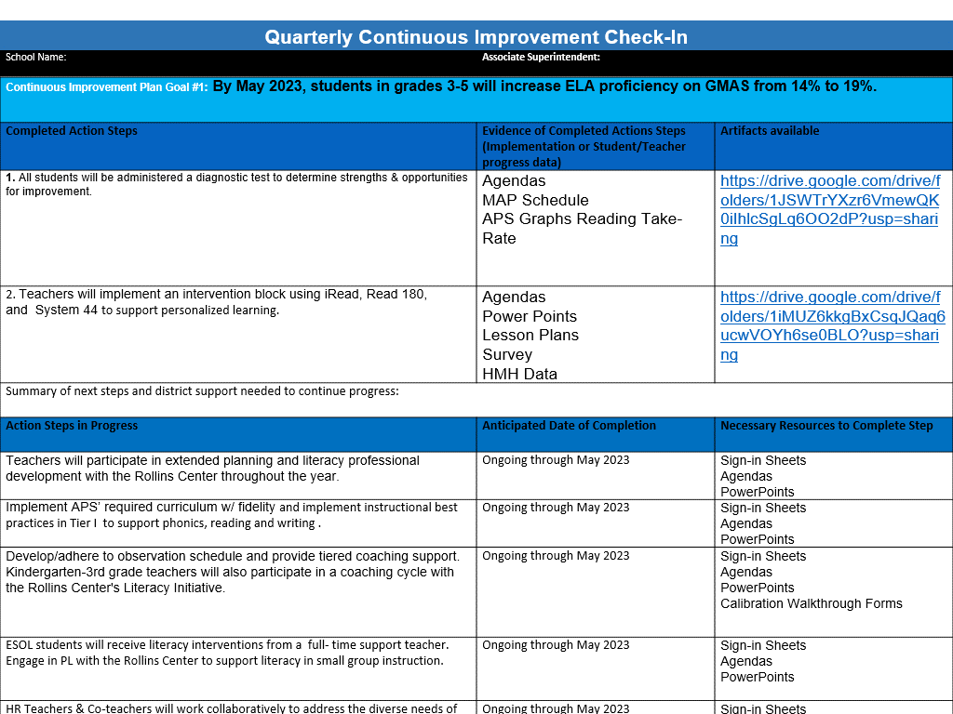
Insert a slide with the indicated fieldsfor each CIP Goal for your school
Quarterly Continuous Improvement Check-In
School Name: | Associate Superintendent:
Continuous Improvement Plan Goal #3:
Completed Action Steps | Evidence of Completed Actions Steps (Implementation or Student /Teacher progress data) | Artifacts available
1.
2.
3.
Summary of next steps and district support needed to continue progress:
Action Steps in Progress | Anticipated Date of Completion | Necessary Resources to Complete Step
Summary of next steps and district support needed to complete action steps currently in progress:
Pending Action Steps | Anticipated Start Date | Necessary Resources to Begin/Complete Step
Summary of next steps and district support needed to start action steps:

Slide 6
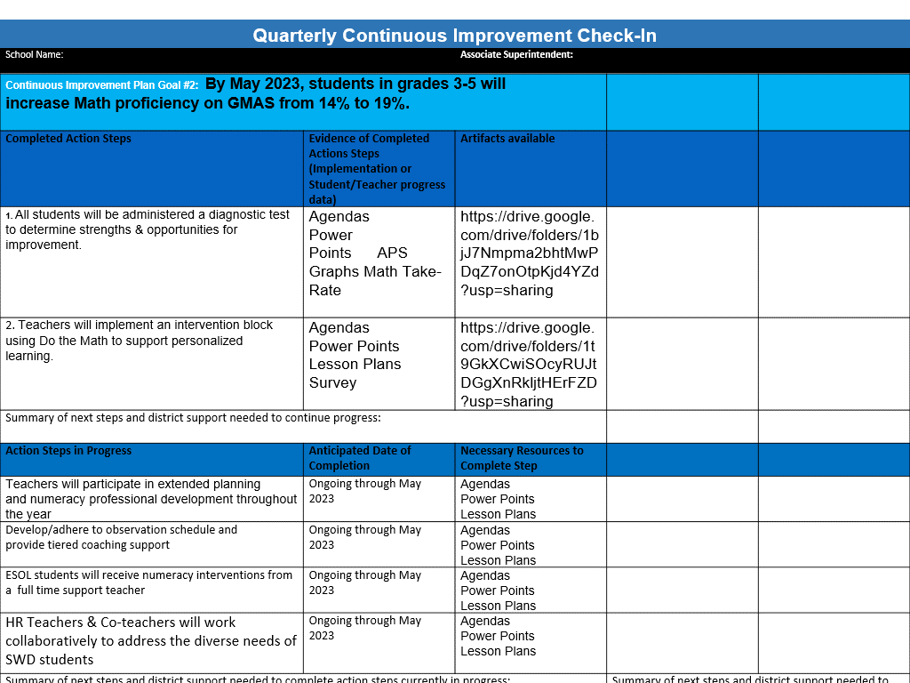
Insert a slide with the indicated fields for each CIP Goal for your school
Quarterly Continuous Improvement Check-In
School Name: | Associate Superintendent:
Continuous Improvement Plan Goal #3:
Completed Action Steps | Evidence of Completed Actions Steps (Implementation or Student /Teacher progress data) | Artifacts available
1.
2.
3.
Summary of next steps and district support needed to continue progress:
Action Steps in Progress | Anticipated Date of Completion | Necessary Resources to Complete Step
Summary of next steps and district support needed to complete action steps currently in progress:
Pending Action Steps | Anticipated Start Date | Necessary Resources to Begin/Complete Step
Summary of next steps and district support needed to start action steps:

Slide 7
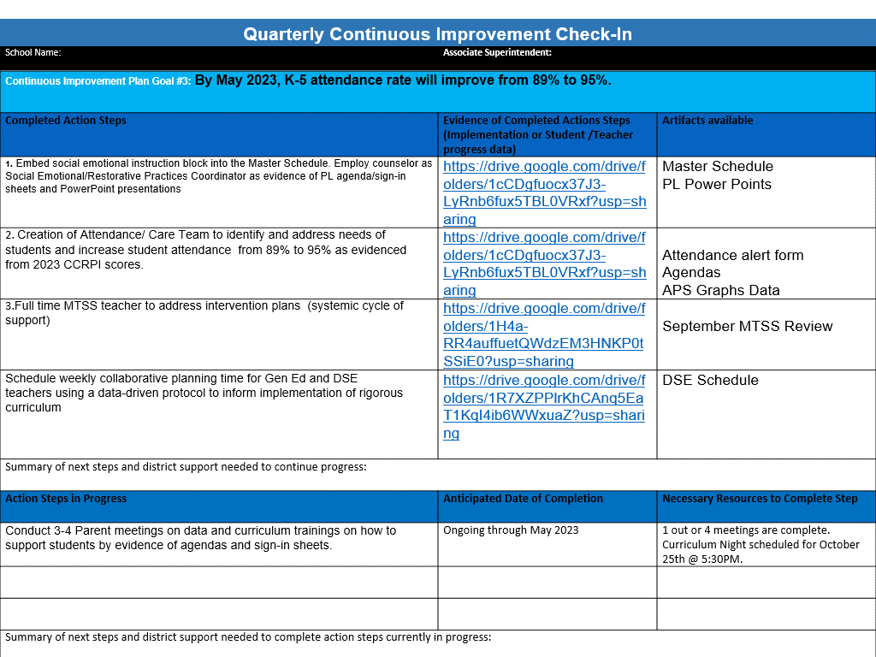
Insert a slide with the indicated fields for each CIP Goal for your school
Quarterly Continuous Improvement Check-In
School Name: | Associate Superintendent:
Continuous Improvement Plan Goal #3:
Completed Action Steps | Evidence of Completed Actions Steps (Implementation or Student /Teacher progress data) | Artifacts available
1.
2.
3.
Summary of next steps and district support needed to continue progress:
Action Steps in Progress | Anticipated Date of Completion | Necessary Resources to Complete Step
Summary of next steps and district support needed to complete action steps currently in progress:
Pending Action Steps | Anticipated Start Date | Necessary Resources to Begin/Complete Step
Summary of next steps and district support needed to start action steps:

Slide 8
Strategic Plan Progress

Slide 9
Peyton Forest
SMART Goals
  By May 2023, students in grades 3-5 will increase ELA proficiency on GMAS from 14% to 19%.
By May 2023, students in grades 3-5 will increase Math proficiency on GMAS from 14% to 19%.
May 2023, K-5 attendance rate will improve from 89% to 95%.
APS Strategic Priorities
& Initiatives
School Strategic Priorities
School Strategies
Fostering Academic
Excellence for All
Data
Curriculum & Instruction
Signature Program
1.Use data to drive instruction and academic decisions.
2. .Increase academic achievement in core subject areas.
3. Engage in monthly IB trainings for staff
1.Conduct personalized monthly student data meetings.
2. Increase small group instruction.
3. Implement daily phonemic awareness and phonics instruction (FUNdations & Rollins Center).
4. Integrate writing across the curriculum
5. Use MAP data to guide student intervention groups.
6. Conduct 90 minutes of IB PL monthly.
Building a Culture of
Student Support
Whole Child & Intervention Personalized Learning
4. Increase student attendance & engagement
5.Implement a Whole-Child system of supports that integrates social-emotional learning, behavior, wellness, and comprehensive academic intervention plans
1.Provide monthly student attendance initiatives
2. Provide monthly parent newsletters focused on attendance
3. Attendance team will contact by phone and in writing the parents of students with chronic absenteeism.
4. Provide small group mental health interventions led by Counselor
5. Provide daily SEL lessons
6. Implement District Personalized Learning Pathway
Equipping & Empowering
Leaders & Staff
Strategic Staff Support
Equitable Resource Allocation
Build teacher capacity to support the core content knowledge emotional/behavioral needs of students
1.100% of staff will receive IBO Training
2.Increase the number of classroom teachers who are gifted endorsed
3. Implement cognitive development initiatives
4. Provide ongoing PL on SEL & trauma-informed practices
Creating a System of School Support
Strategic Staff Support
Equitable Resource Allocation
7. Sustain family engagement that encourages positive relationships with the school and academic partnerships for children.
1.Maintain and active Go Team each with clear goals and objectives for parent leadership.
2. Conduct monthly family engagement opportunities.

Slide 10
Activity & Discussion
Review the priorities and goals in your strategic plan and reflect on if the expected progress is being made. These guiding questions will help you determine what, if any, updates are needed for your school’s strategic plan.
Are all CIP Goals reflected in our Strategic Plan Priorities? If not, which CIP Goal(s) are missing and should be added to the Strategic Plan?
  YES
What progress has been made towards the priorities identified in our Strategic Plan? What evidence/data do we have?
  Parent engagement activities.
  IB, ELA and Math PL
  WIN BLock: Intervention
  SEL daily implementation
Based upon available data, are there any other adjustments we need to make to the Strategic Plan?
  Attendance- Effective communication between the teacher and parent.
  Class Dojo
  Parent Newsletter to remind parents about absence protocols
  Hazel Health

Slide 11
Updates to the
Strategic Plan
Enter all changes/updates to your plan – be sure to include accountability measures, as appropriate.

Slide 12
Be prepared for our next meeting:
At our NEXT meeting
1
2
3
4
5
1
2
3
4
5
Fall 2021
GO Team Developed 2021-2025 Strategic Plan
Summer 2022
School Leadership completed Needs Assessment and defined overarching needs for SY22-23
August 2022
School Leadership completed 2022-2023 Continuous Improvement Plan
Sept. – Dec. 2022
Utilizing current data, the GO Team will review & update the school strategic priorities and plan, as needed
Before Winter Break
GO Team will take action (vote) on the school’s strategic plan and vote on the ranked strategic plan priorities for SY23-24 budget discussions.

Slide 13
Questions?
Wonderings?
Comments?

